Slide 1


Cooper Heaton
12/20/2023

Slide 2

Outline
Executive Summary
Introduction
Methodology
Results
Conclusion
Appendix

Slide 3
Executive Summary
Summary of methodologies
Data Collection with API
Data Collection with Web Scraping
Data Wrangling
Exploratory Data Analysis with SQL
Exploratory Data Analysis with Data Visualization
Interactive Visual Analytics with Folium
Machine Learning Prediction
Summary of all results
Exploratory Data Analysis result
Interactive Analytics with Screenshots
Predictive Analytics Result

Slide 4
Introduction
Project background and context
Problems you want to find answers
What factors will determine if the rocket can land successfully?

Slide 5

Section 1

Slide 6
Methodology
Executive Summary
Data collection methodology:
Data was collected using SpaceX API and web scraping from Wikipedia.
Perform data wrangling
One-hot encoding was applied to categorical features.
Perform exploratory data analysis (EDA) using visualization and SQL
Perform interactive visual analytics using Folium and Plotly Dash
Perform predictive analysis using classification models
How to build, tune, evaluate classification models

Slide 7
Data Collection
A get request to the SpaceX API was used to collect the data.
Next, decode the response using .json() function and turn it into a pandas dataframe with .json_normalize().
Then, clean the data and fill in missing values when necessary.
To get the Falcon 9 launch records we must perform web scraping with BeautifulSoup.
Once we have the launch records we need to parse the data and convert it to a pandas dataframe for future analysis.

Slide 8
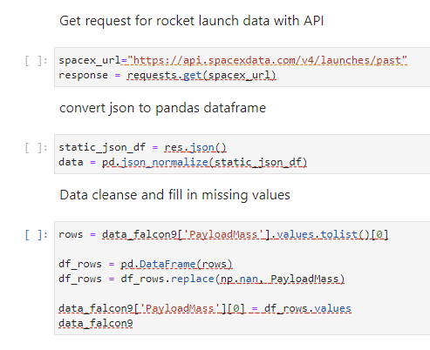
Data Collection – SpaceX API
We called a get request to the SpaceX API to collect data and then clean the data
https://github.com/cheaton622/IBMDataScienceCapstone/blob/main/jupyter-labs-spacex-data-collection-api.ipynb

Slide 9
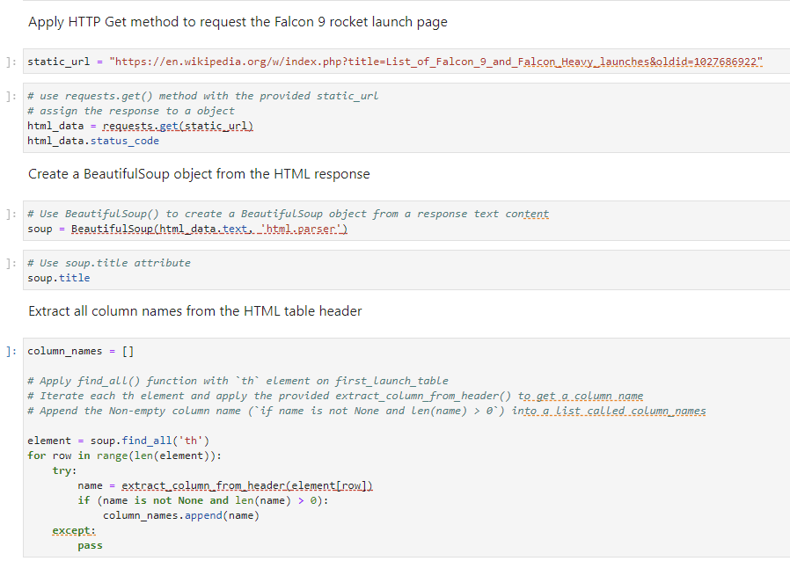
Data Collection - Scraping
Use BeautifulSoup to webscrape Falcon 9 launch records then parse the data and convert it to a pandas dataframe
https://github.com/cheaton622/IBMDataScienceCapstone/blob/main/jupyter-labs-webscraping.ipynb

Slide 10
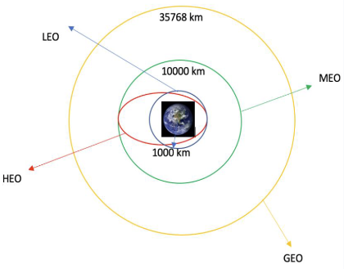
Data Wrangling
I explored the data to determine training labels
Then calculated the number of launches at each site and the count of occurrences for each orbit
Lastly, I used the outcome column to create a landing outcome column and exported the results to a csv file.
https://github.com/cheaton622/IBMDataScienceCapstone/blob/main/labs-jupyter-spacex-Data%20wrangling.ipynb

Slide 11
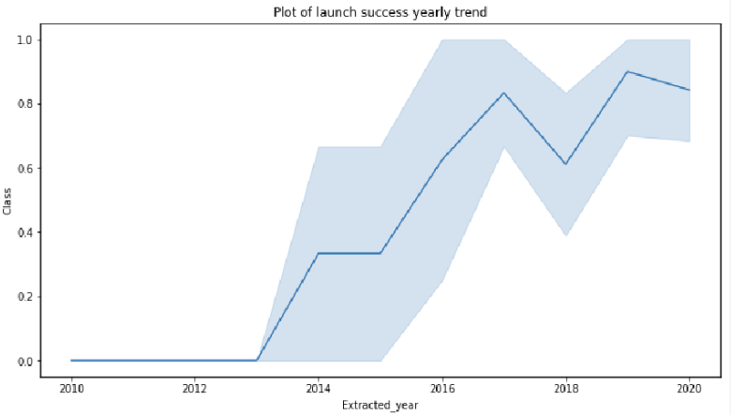

EDA with Data Visualization
I explored the data by visualizing the relationship between flight number/launch site, payload/launch site, success of each orbit type, flight number/orbit type and a yearly trend of launch success
https://github.com/cheaton622/IBMDataScienceCapstone/blob/main/jupyter-labs-eda-dataviz.ipynb.jupyterlite.ipynb

Slide 12
EDA with SQL
I used a sqlite to store the SpaceX dataset
I used queries to EDA within the sqlite database such as:
Display the unique launch sites
Total payload mass carried by boosters launched by NASA
Average payload mass carried by booster version F9 v1.1
List boosters which have success in drone ship and have payload mass greater than 4000 but less than 6000
https://github.com/cheaton622/IBMDataScienceCapstone/blob/main/jupyter-labs-eda-sql-coursera_sqllite.ipynb

Slide 13
Build an Interactive Map with Folium
First, I marked all launch sites and used map objects to specify the success/failure of launches for each site on the folium map
Assign the launch outcomes to 0 for failure and 1 for success
Identify the launch sites with a high success rate using color-labeled n=marker clusters
Calculate the distances between launch sites to see if they are near major structures such as cities, railways, highways, and oceans
https://github.com/cheaton622/IBMDataScienceCapstone/blob/main/lab_jupyter_launch_site_location.ipynb

Slide 14
Build a Dashboard with Plotly Dash
On the dashboard there is a pie char that show the total launches by certain launch sites, as well as a scatter plot showing the relationship between outcome/payload mass for different booster versions
https://github.com/cheaton622/IBMDataScienceCapstone/blob/main/app.py

Slide 15
Predictive Analysis (Classification)
Load, transform, and split the data into training/testing sets with numpy and pandas
Build machine learning models and tune different hyperparameters with GridSearchCV
Improve the accuracy of the model with feature engineering and tuning the algorithm to find the best performing classification model
https://github.com/cheaton622/IBMDataScienceCapstone/blob/main/SpaceX_Machine_Learning_Prediction_Part_5.jupyterlite.ipynb

Slide 16
Results
Exploratory data analysis results
Interactive analytics demo in screenshots
Predictive analysis results

Slide 17

Section 2

Slide 18
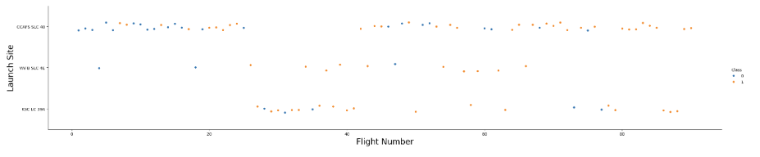
Flight Number vs. Launch Site
The findings of this comparison is that the larger the flight amount at a launch site equals a greater success rate

Slide 19
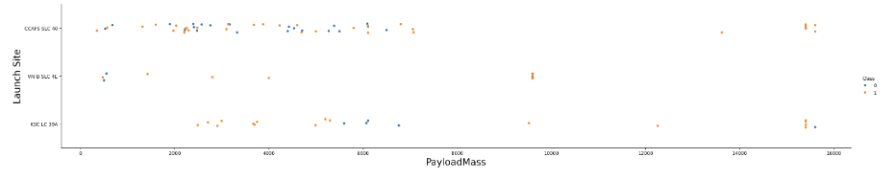
Payload vs. Launch Site
The greater the payload mass typically means there will be a higher success rate for that launch site

Slide 20

Success Rate vs. Orbit Type
From the graph, we can see that ESL-1, GEO, HEO, and SSO had the highest success rate of each orbit

Slide 21
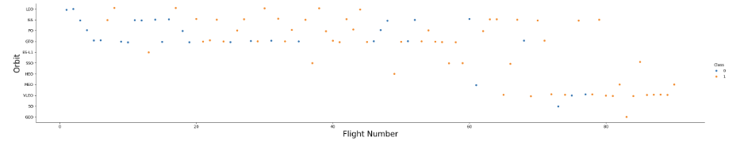
Flight Number vs. Orbit Type
This plot shows that the more flights will yield a higher success rate for each orbit

Slide 22
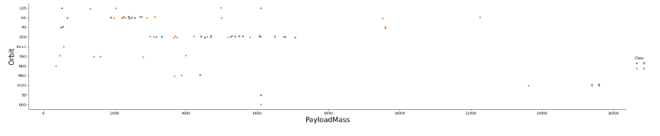
Payload vs. Orbit Type
Most orbit sites use a smaller payload to yield a high success rate except for PO, YLEO, and ISS

Slide 23
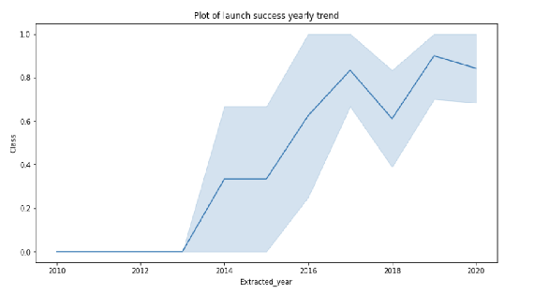
Launch Success Yearly Trend
The line chart shows that launch success has increased significantly since 2013

Slide 24
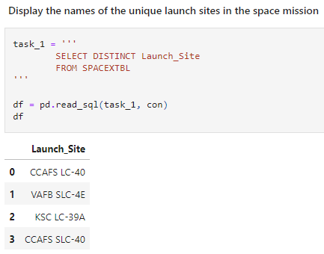
All Launch Site Names
In this query ‘DISTINCT’ is used to show only unique launch site names

Slide 25
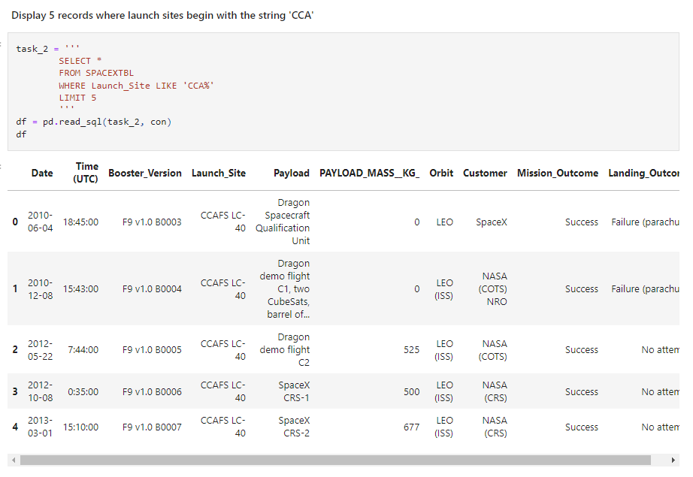
Launch Site Names Begin with 'CCA'
LIMIT 5 is used to select only the first 5 rows

Slide 26
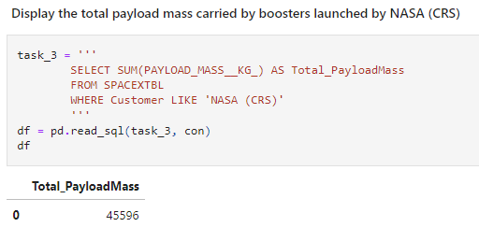
Total Payload Mass
Display the sum of payload mass by using the SUM() function
Specify the customer using a WHERE statement

Slide 27
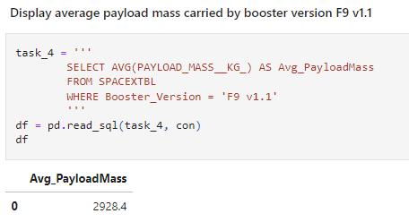
Average Payload Mass by F9 v1.1
The average payload mass carried by booster version F9 v1.1 is 2,928.4 kg

Slide 28
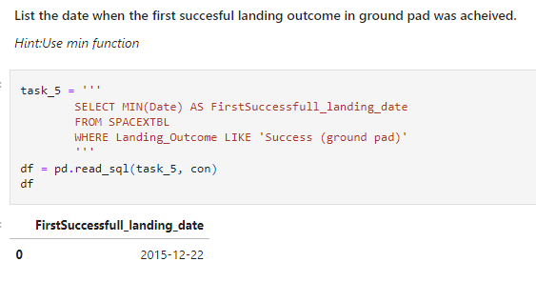
First Successful Ground Landing Date
The date of the first successful ground landing date is December 22, 2015

Slide 29
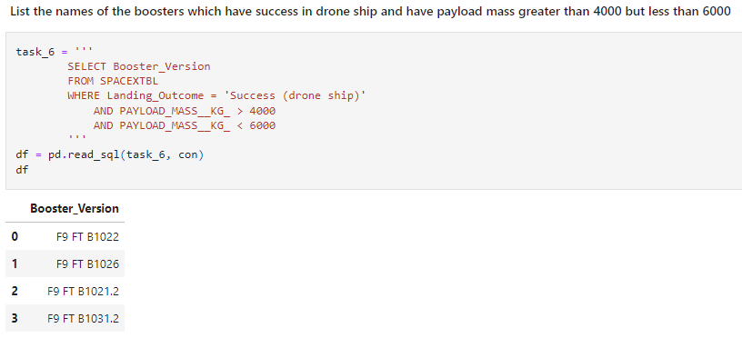
Successful Drone Ship Landing with Payload between 4000 and 6000
There have been 4 different booster versions to land successfully with a payload between 4,000 and 6,000

Slide 30
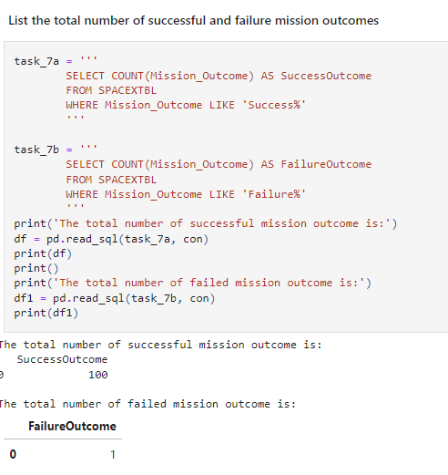
Total Number of Successful and Failure Mission Outcomes
We used the wildcard feature “%” to find that there were 100 successful outcomes and 1 failure

Slide 31
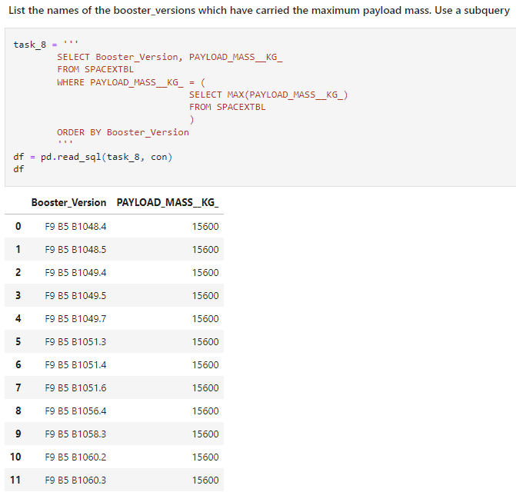
Boosters Carried Maximum Payload
In this query there is a subquery that has a WHERE clause using the MAX() function to determine which booster versions have used the maximum payload mass

Slide 32
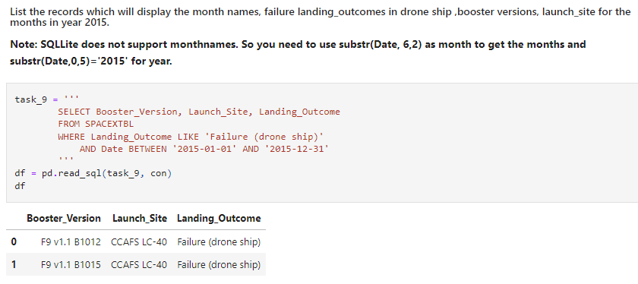
2015 Launch Records
This query uses a WHERE clause to specify that landing outcome equals failure and it is in the year 2015

Slide 33
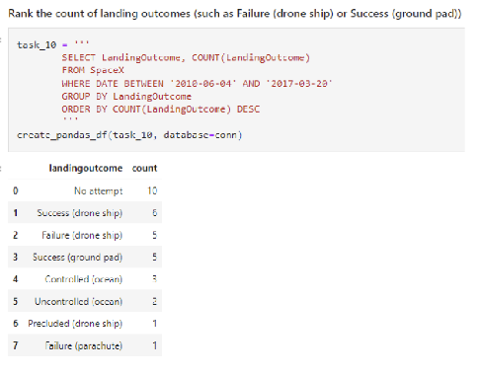
Rank Landing Outcomes Between 2010-06-04 and 2017-03-20
This query shows the landing outcomes in the dates between 2010-06-04 and 2017-03-20.
The outcomes are sorted by count in descending order using the ORDER BY clause

Slide 34

Section 3

Slide 35
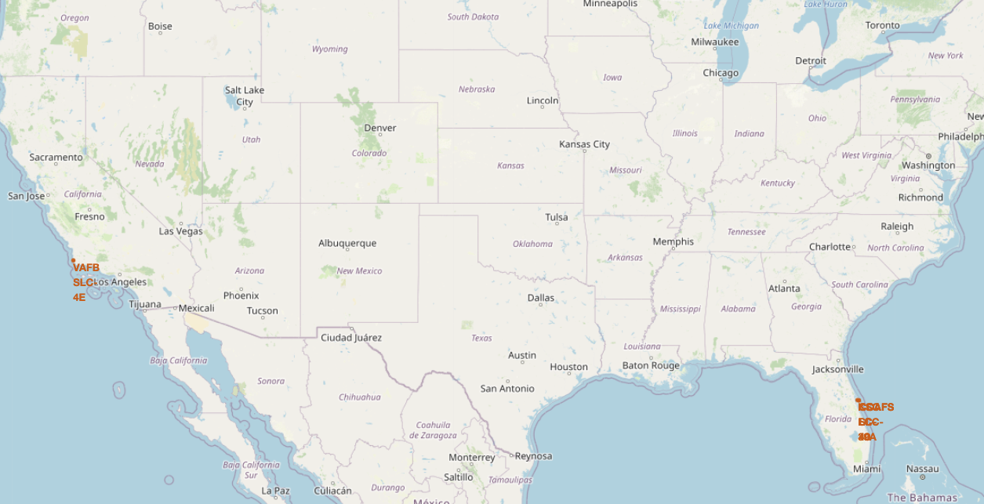
SpaceX Launch Sites
SpaceX launch sites are on the coasts of Florida and California

Slide 36
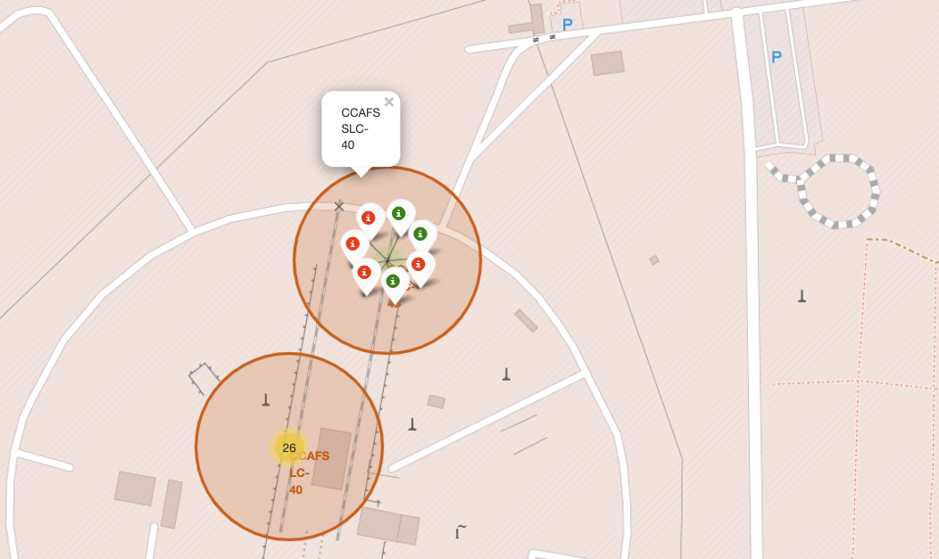
Launch Sites with Color Labels
These are the Florida launch sites
The green indicate successful launches and red are unsuccessful

Slide 37
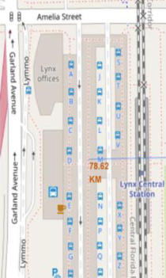
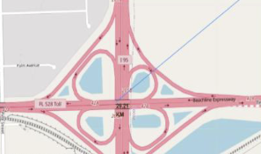
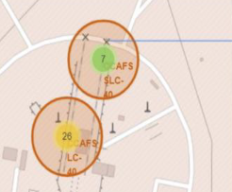
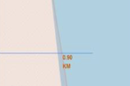
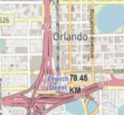
Launch Sites Proximity to Major Landmarks
Launch sites are not close to railways, highways, or cities
Launch sites are close to coastlines
Distance to Highway
Distance to Railway
Distance to Coast
Distance to Coastline
Distance to City

Slide 38

Section 4

Slide 39
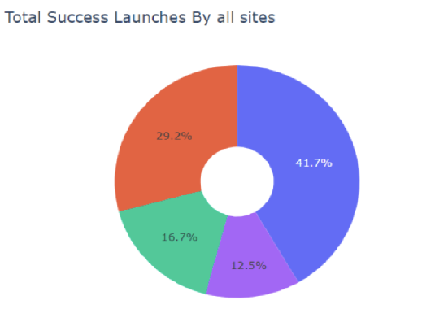
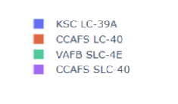
Success Percentage by Launch Site
KSC LC-39A has the highest success rate

Slide 40
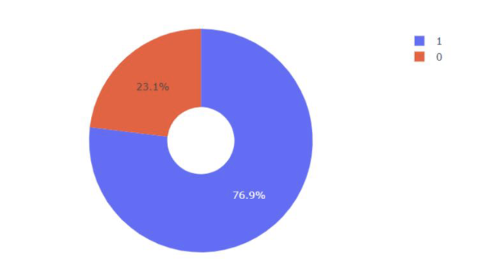
Launch Site with the Highest Success Ratio
KSC LC-39A achieved a 76.9% success percentage

Slide 41
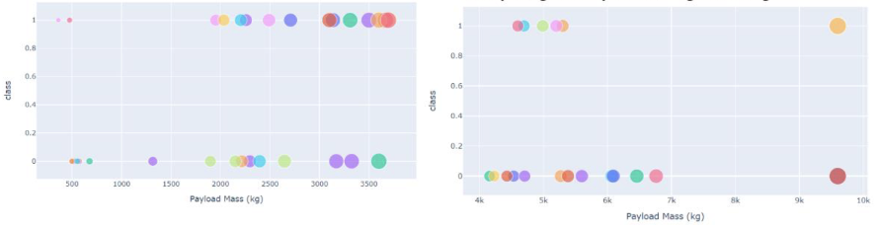
Payload vs Launch Outcome for Each Site
The success rate for lower weighted payloads is higher than the heavy weighted payloads
Payload 0-4000kg
Payload 4000-10000kg

Slide 42

Section 5

Slide 43
Classification Accuracy
The decision tree classifier model has the highest accuracy

Slide 44
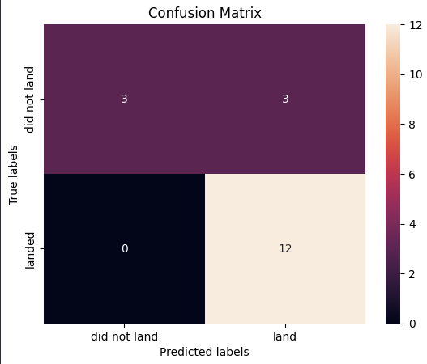
Confusion Matrix
The confusion matrix for the decision tree classification model shows how well the model can distinguish between the different classes.
It also shows that the classifier could have been more accurate if it did not mark unsuccessful landings as successful

Slide 45
Conclusions
Launch sites had greater success rates when they had a higher number of flights.
Launch success rate has increased dramatically over time.
The orbits with the highest success rates were ES-L 1, GEO, HEO, SSO, and VLEO.
The launch site with the highest success rate was KSC LC-39A.
The decision tree classifier was the most successful algorithm to predict if the first stage would land.

Slide 46
Appendix
All of my relevant assets are on my GitHub repository:
https://github.com/cheaton622/IBMDataScienceCapstone/tree/main

Slide 47


